Slide 1
Black Scholes Philosophy

Slide 2
Black Scholes Philosophy
Explain the connections between change of measure, martingales, risk-neutrality, memory and fractals.
Quiz: 10-step tree
Are European option prices martingales in the BS framework?
Are American option prices martingales in the BS framework?

Slide 3
Von Neumann Chart
Personality | Discounted Exp Vs. Market Price | Utility | Stochastic Process | Sharpe ratio
Risk Averse
Risk Neutral
Risk Loving

Slide 4
Von Neumann Chart
Personality | Discounted Exp (DE) Vs. Market Price (MP) | Utility | Stochastic Process | Sharpe ratio
Risk Averse | MP < DE | Concave | Sub-martingale | positive
Risk Neutral | MP = DE | linear | martingale | 0
Risk Loving | MP > DE | convex | super-martingale | negative

Slide 5
CRR formalism
Quiz : Limiting distributions
The CRR tree… does the price converge to anything?
What happens to the stock price at expiration? What is its probability distribution?
Do you believe that stock price distribution is correct?

Slide 6

Black Scholes Formulae
$$c=S_{0} N(d_{1})−K e^{−rT}N(d_{2}) \\ p=K e^{−rT} N(−d_{2})−S_{0} N(−d_{1}) \\ \text{where} d_{1}=\frac{\ln{(}S_{0}/K)+(r+σ^{2}/2)T}{σ\sqrt{T}} \\ d_{2}=\frac{\ln{(}S_{0}/K)+(r−σ^{2}/2)T}{σ\sqrt{T}}=d_{1}−σ\sqrt{T}$$

Slide 7
Quiz: Geometric Brownian motion
SDE: Geometric Brownian motion
Recall limit of symmetric random walk becomes normal under “suitable” limiting case.
Derive the sde as limit of CRR tree.

Slide 8
The self-financing equations
What is meant by self financing dynamic hedge?
Quiz: Self financing.
Write down the self financing equations.
Take the limits…what do you get?

Slide 9

Black Scholes differential Equation
$$\frac{∂ƒ}{∂t}+rS\frac{∂ƒ}{∂S}+½ σ^{2}S^{2}\frac{∂^{2}ƒ}{∂S^{2}}=rƒ$$
f is the value of the derivative or derivative
portfolio to be priced.

Slide 10
Greeks of derivatives
gamma
Theta
$$\frac{∂ƒ}{∂t}+rS\frac{∂ƒ}{∂S}+½ σ^{2}S^{2}\frac{∂^{2}ƒ}{∂S^{2}}=rƒ$$
Delta

Slide 11
Quiz: BS differential equation
Do you need a probability distribution to get the BS differential equation?
How does the BS differential equation give you the price of derivatives?
This is a celebrated equation from physics. What is this equation?

Slide 12

Quiz: Ito’s lemma
What have we used in the derivations that need some more explanation?
Stochastic calculus rules…. ${\left(dB\right)}^{2}=dt, dB.dt=0$???
Ito’s lemma? What is this?

Slide 13
Simulation de Monte Carlo
Use gbm
Simulate 10,000 paths for a stock
Price a call, put

Slide 14
Simulation de Monte Carlo
How do you know that the simulations are giving us a correct answer?
Did you check if the replication equations are satisfied?
Quiz: PDE or probability?

Slide 15
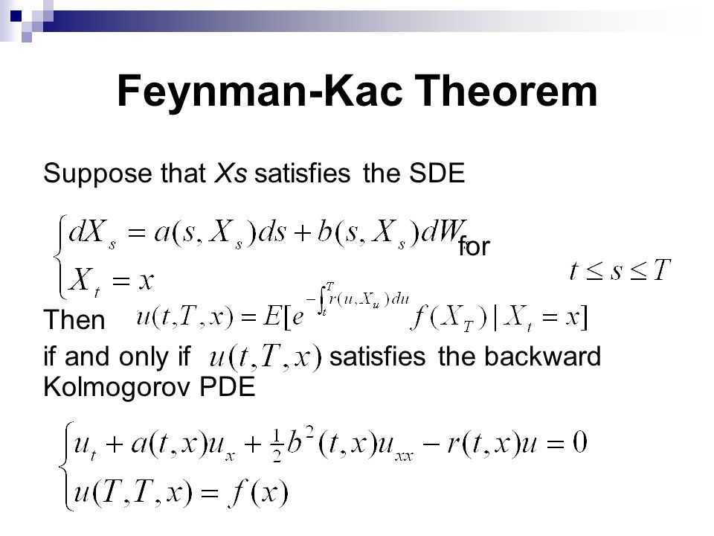

Slide 16
The feynman-Kac theorem
The statement of Feynman-Kac.
Is this statement believable?
Dirichlet theorem
Feynman’s philosophy.

Slide 17
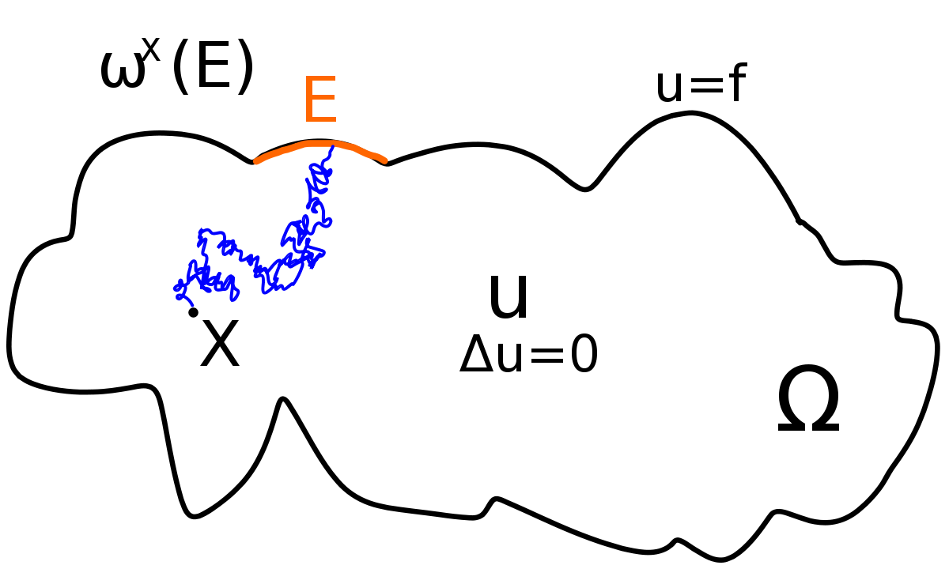
The Dirichlet problem from classical physics

Slide 18

More Simulation de Monte Carlo
Price a log contract that pays $\ln\left(S\right)$ at expiration.
Price a derivative that pays $S^{2}$ at expiration.
Price anything you want! Asian, barrier….

Slide 19
Appendix

Slide 20
Heat Equation or Black Scholes Diff Eqn
f is the value of the derivative or derivative
portfolio to be priced.

Slide 21
Formula! (Solving the Heat Eqn)

Slide 22
The Derivation of the Black-Scholes Differential Equation

Slide 23
The Derivation of the Black-Scholes Differential Equation continued

Slide 24
The Derivation of the Black-Scholes Differential Equation continued

